Slide 1
What’s the Tea: Topic Classification of News Articles
Group 3
By:
Advith Chegu (ac1771)
Vipul Gharde (vig4)
Diksha Wuthoo (dw659)

Slide 2
Agenda
Introduction
Objectives
Dataset description with ER diagram
Challenges with massive dataset
Our approach
Conceptual flowchart and architecture diagram
Model architecture explained
Experimental results and its analysis
Technologies Used and Target Users
Improvements from Project 1
Future Scope

Slide 3
Introduction
A large volume of news articles are present on the Internet that potentially belongs to some category
Users should be able to search for news articles from particular topics
Our project focuses on Twitter data, where numerous news Tweets can be found and we want to classify them into topics.

Slide 4
Objectives
Our application helps the targeted Twitter users know what the ‘popular’ news topics are in real-time
‘Popular’ is defined as the topics having the most number of counts from recent news Tweets
Users can see the top ‘N’ trending topics and can select any one of them to see the related news articles

Slide 5
Dataset Description
We are using different datasets:
Number of records
HuffPost dataset - 210,000 articles (~100MB)
RealNews dataset - 40,000,000 articles (~10GB)
Real-time Tweets (~320 tweets) - For testing the model
Total number of records: 40,210,640
Average size per record: 0.5 KB
There are 42 topics in which the articles can be classified. For example, Sports, Politics, Entertainment, etc.
We are using the summary and category column from the dataset
Rate of processing: 70 records / second

Slide 6
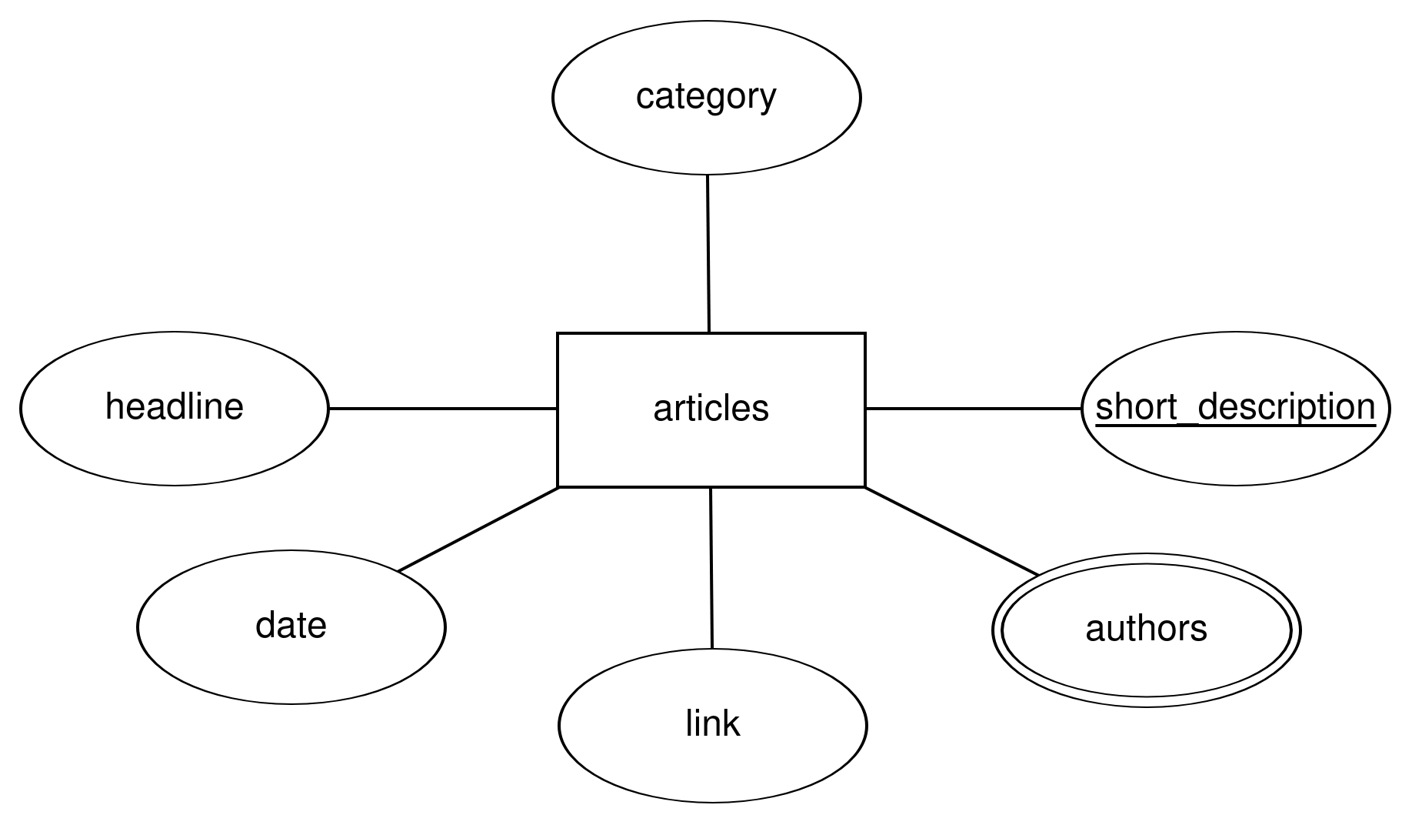
HuffPost ER Diagram

Slide 7
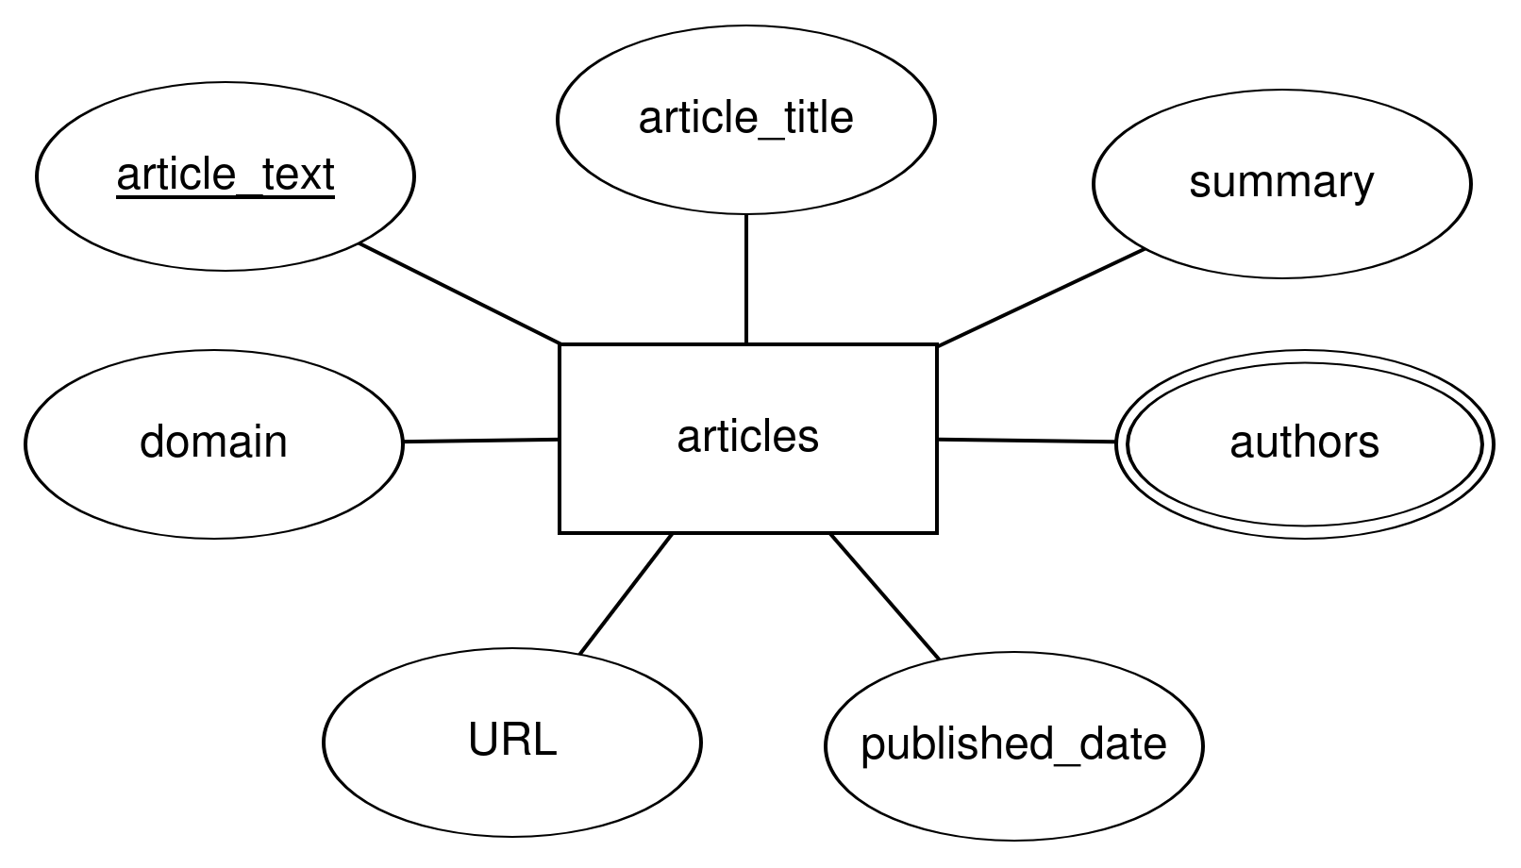
RealNews ER Diagram
Notes:
Diksha last slide

Slide 8
Challenges of Massive Data
We had a large amount of unlabeled data (40 million) which we wanted to use for training the model
Used a pre-trained model (all-MiniLM-L6-v2) to generate the labels for the unlabeled dataset using cosine-similarity
Used the articles with respective labels to generate the embeddings which are then passed to our model
Notes:
Advith first slide t5 small model

Slide 9
Our Approach
Preprocess the text articles and generate word embeddings, then pass it to deep learning CNN model for the classification task as convolution layers are better at understanding the features from the embeddings
Trained the model on the 2 datasets where the input is the news article and the output is the topic that the article belongs to
For testing, we fetched the Tweets from some recognized news handles on Twitter to find the most trending topics
Compared different models (like CNN, LSTM) but we found CNN to have the best accuracy

Slide 10
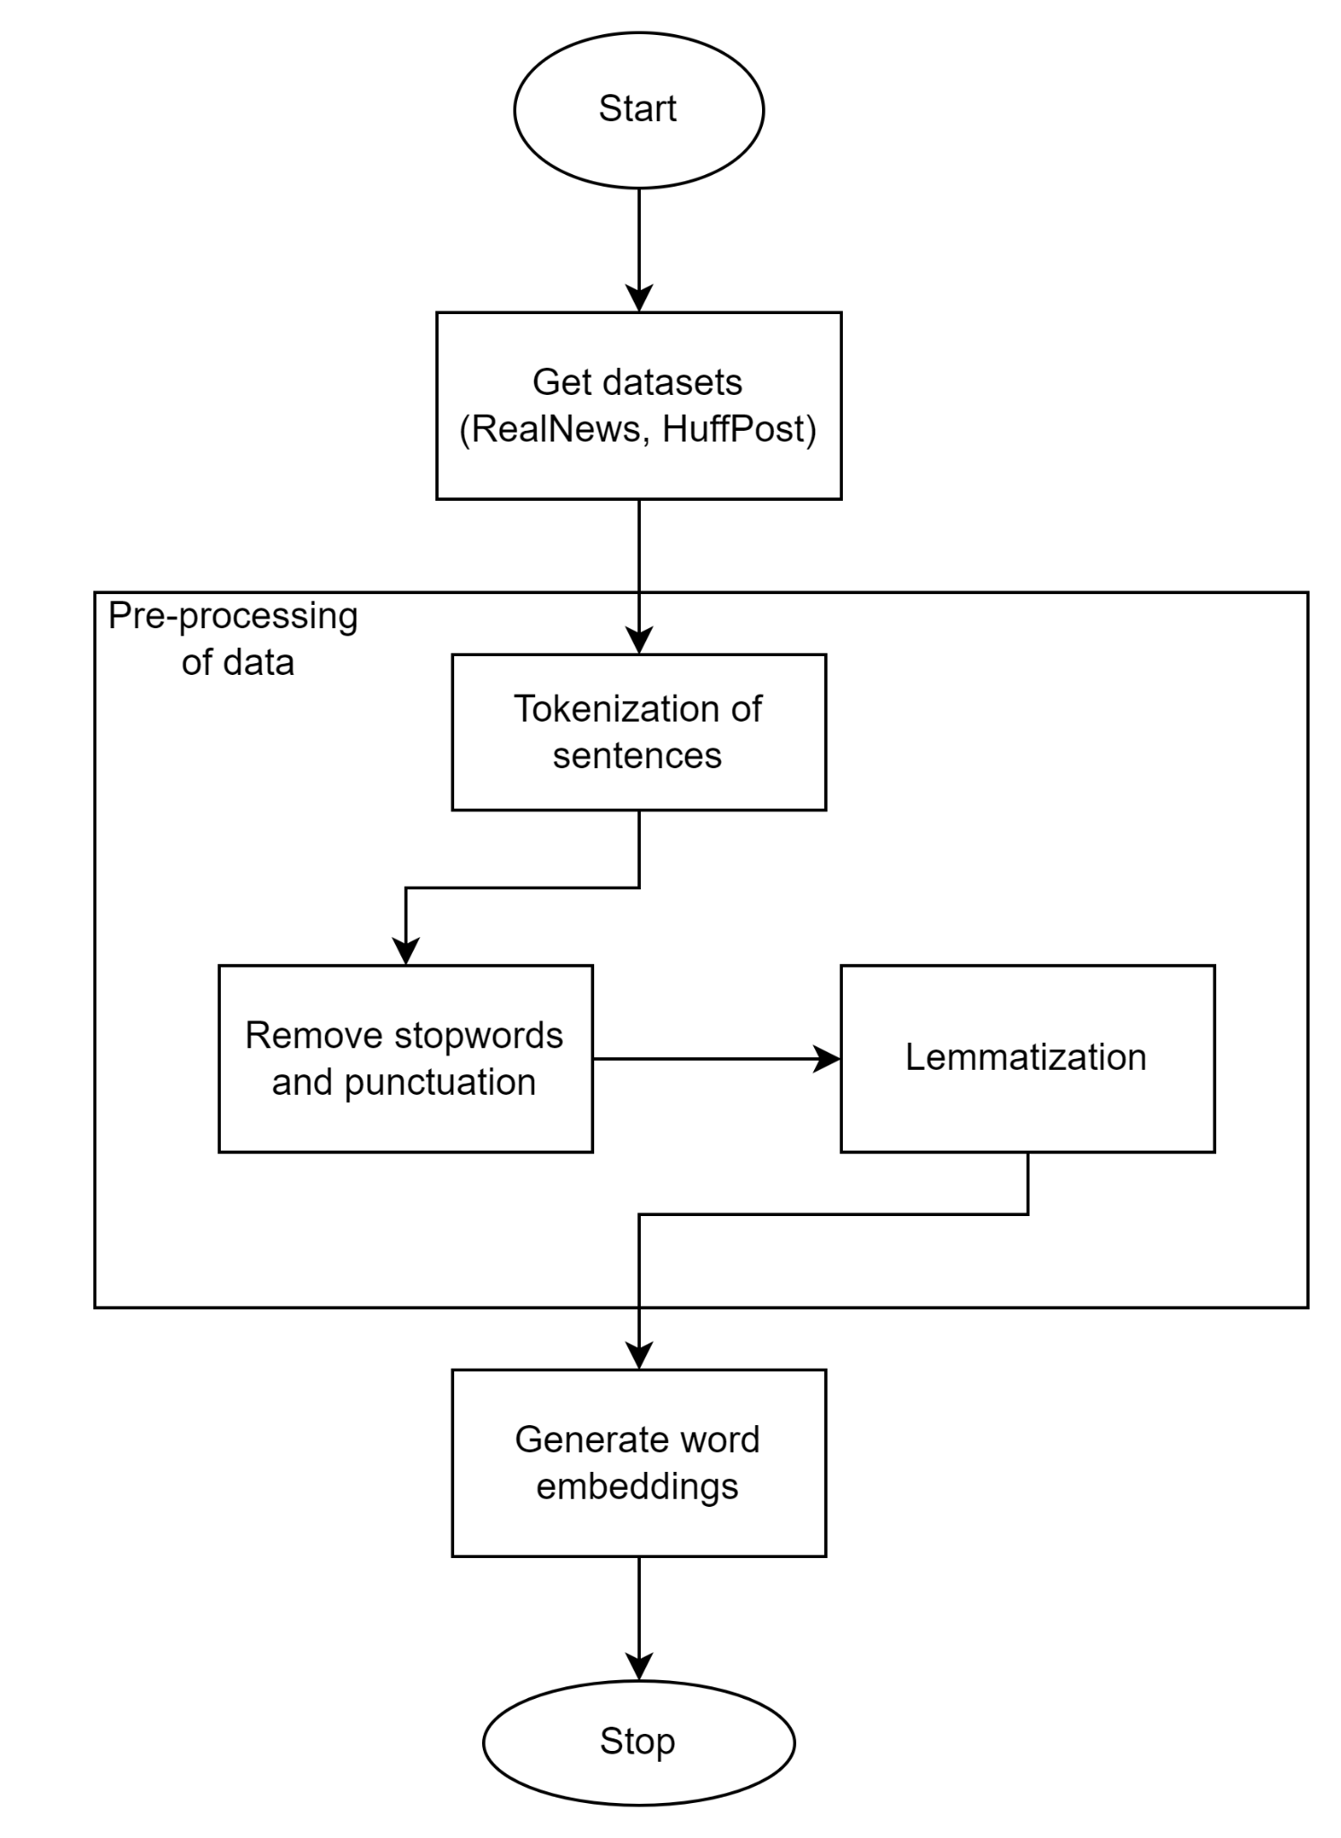
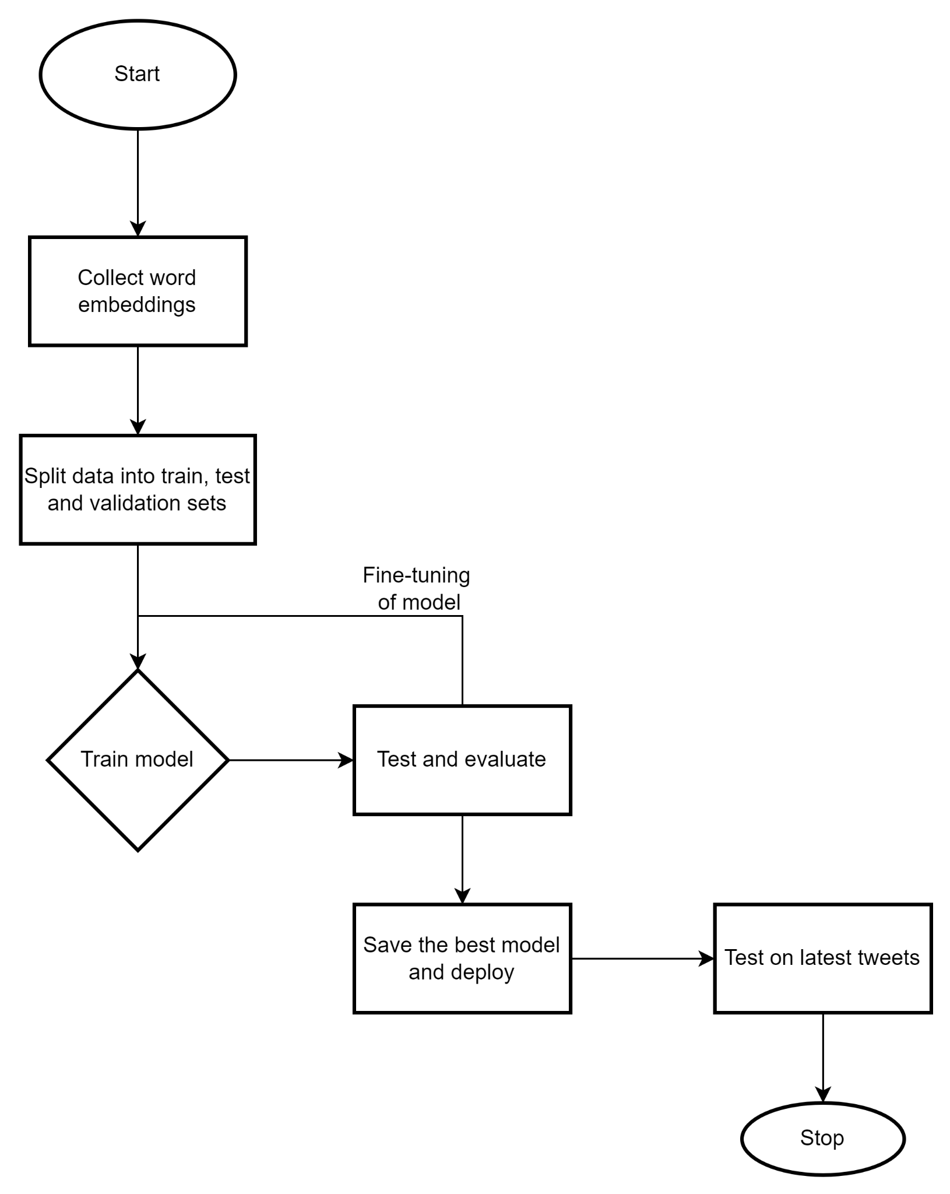
Conceptual Flowchart
Notes:
Advith

Slide 11
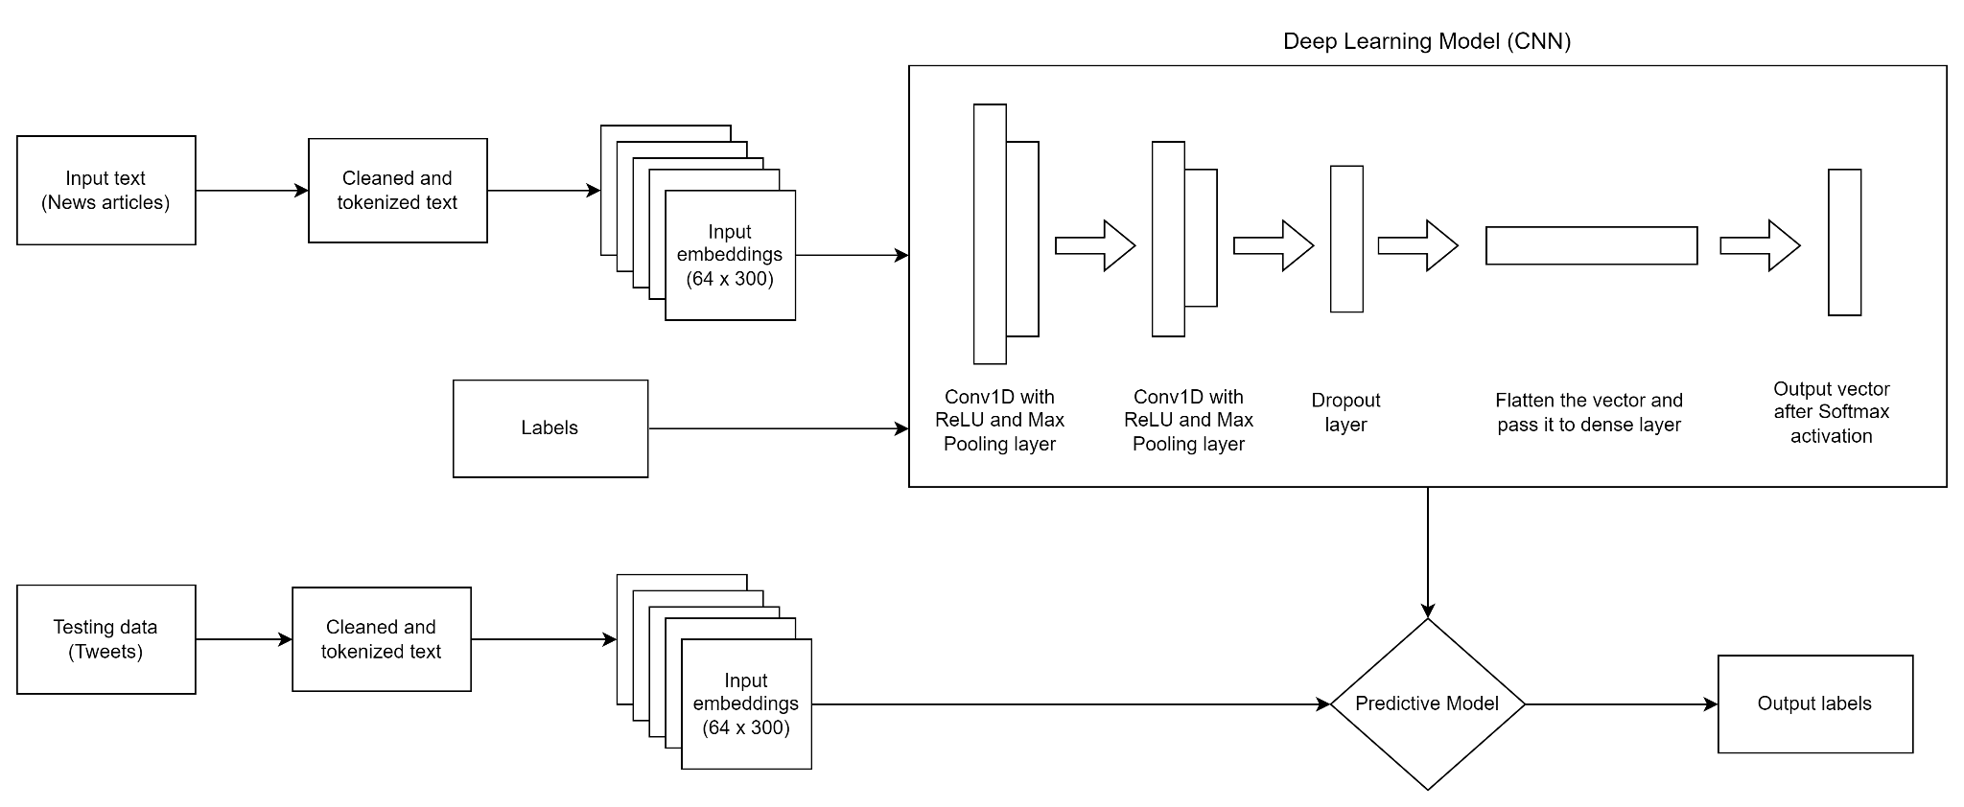
Architecture Diagram
Notes:
Advith

Slide 12
Text Pre-processing
Text data needs to be pre-processed before passing to the model
We are pre-processing each text article to remove stopwords and tokenizing into words using spaCy
Convert words to vectors using spaCy to give us the word embeddings (300 dimensions). We chose spaCy as it gave us better results than PyTorch’s inbuilt embedding layer

Slide 13
Model Architecture
The dataset is split as training, testing and validation sets in the ratio of 8:1:1
Training input set is passed to the model in batch size of 64
Used 2 layers of 1D convolution with a kernel size of 3x3 and ReLU activation function
After every convolution layer, there is a Max Pooling layer with a kernel size of 3x3 to reduce the dimensions without losing meaning representations
Added a dropout layer with a dropout probability of 0.25 to prevent the model from overfitting
Flattened the input which is passed to the 2048x64 dense layer
Outputs the probability for each label (42 classes for our dataset)

Slide 14
Model Hyperparameters
Used CrossEntropyLoss as the loss function which is most commonly used in case of multi-class classification
Used SGD optimizer which showed better results than Adam and RMSProp
Learning rate is set to 0.05
Trained the model on ~50 epochs but the accuracy plateaued after 20 so we reduced the epoch count to 20
Dropout rate of 0.25 and batch size of 64

Slide 15
Experimental Results
We trained the model using different values of hyperparameters
 | Learning Rate | Number of Layers | Epochs | Accuracy
Model 1 | 0.1 | 2 | 20 | 55.5
Model 2 | 0.05 | 2 | 20 | 57.9
Model 3 | 0.01 | 3 | 50 | 54.7

Slide 16
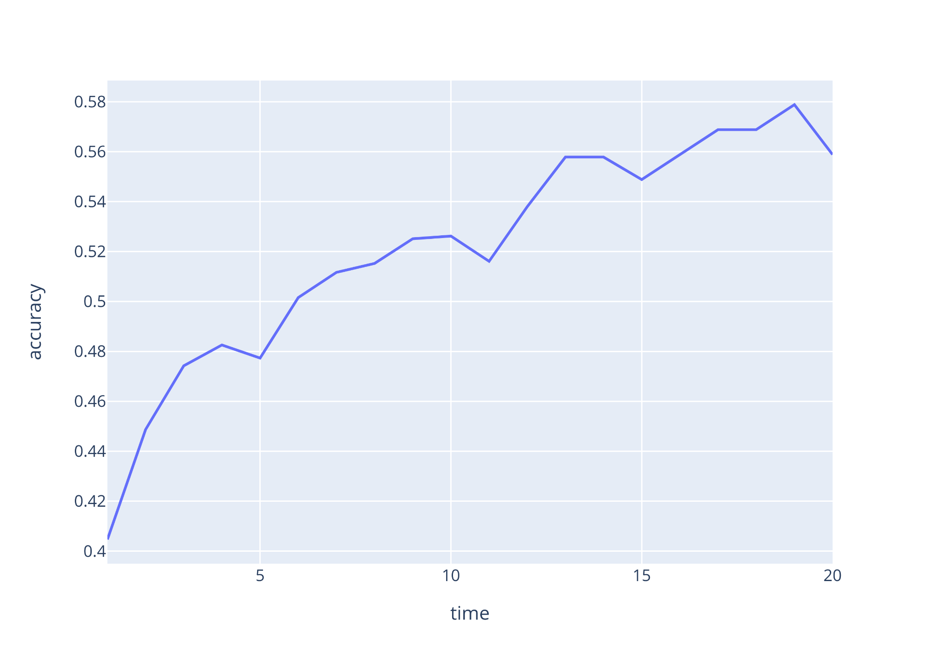
Experimental Results
Graph showing model’s train accuracy vs the number of epochs
Accuracy starts with a higher rate of change but plateaued after ~20 epochs so we reduced the number of epochs
Epoch

Slide 17
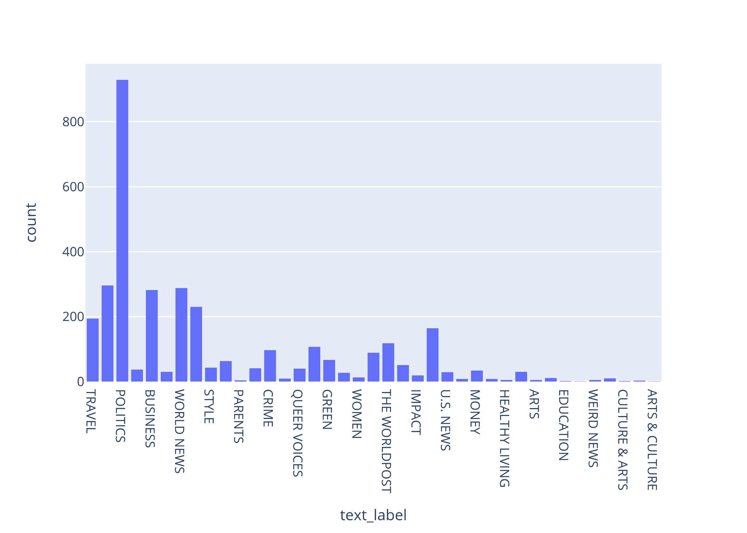
Experimental Results
Trending topics from the latest news Tweets with the count for each topic
We can see that Politics, World News, Business are the most commonly discussed topics on Twitter right now

Slide 18
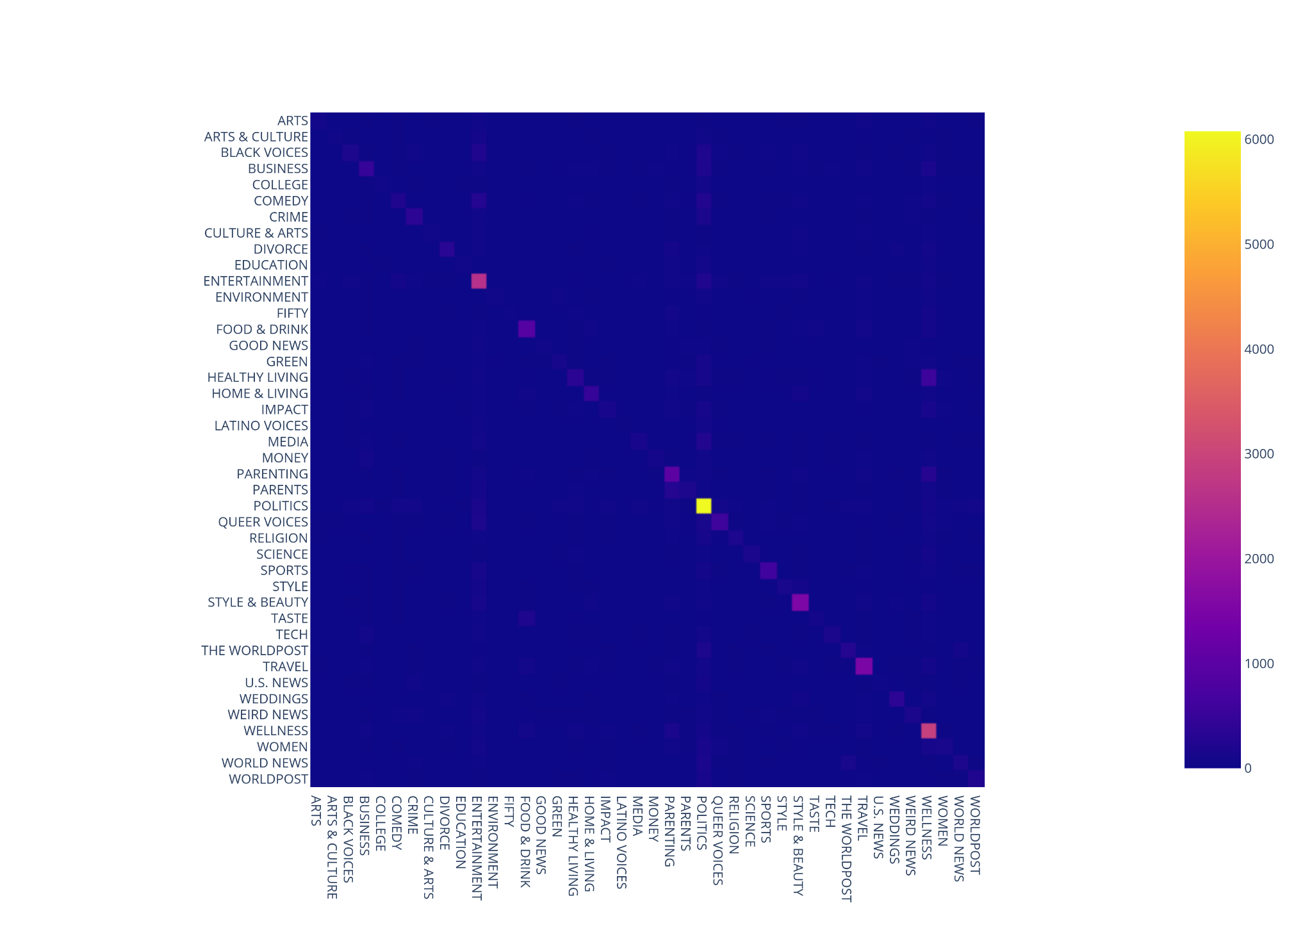
Analysis of model results
Diagonal values show that the labels were correctly predicted
Many topics were misclassified as Politics as there can be overlapping features

Slide 19
Analysis of model results
Accuracy of model can be improved by taking balanced data, i.e. taking equal number of samples for all the classes
Topics like Women, Healthy Living, Art and Culture have lesser samples than Politics, Business, Sports
Generate embeddings using different model like GloVe
Try other model for embeddings instead of spaCy may improve the accuracy
Use 2-dimensional data for text, which captures more features among the different words, may help to increase the accuracy of CNN

Slide 20
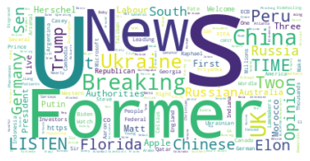
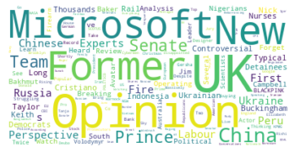
Word clouds for Politics and World News
Politics
World News

Slide 21
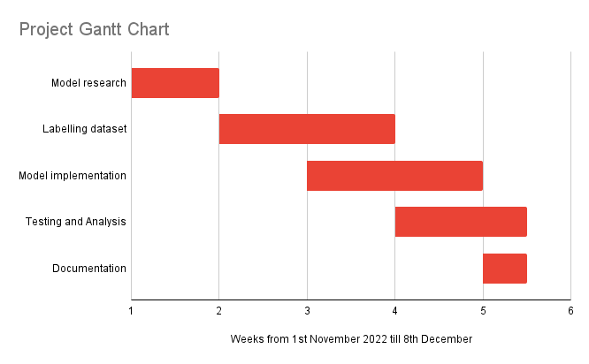

Slide 22
Mode of Processing and Software Tools
Used PySpark and Jupyter Notebooks to process the massive datasets
Used spaCy to remove stopwords and for tokenization
Generated the embeddings using spaCy
Used PyTorch for model training and testing
Used Plotly and MatplotLib to generate the graphs like heatmap and word clouds
Used Flask to generate the APIs

Slide 23
Expected Target Users
Curious news readers who want to be updated with the latest news
For scope of the project, we targeted users who can use our application to find the top trending news topics on Twitter in real-time
Users can fetch the latest Tweets from one particular category and read them on our application
Can be extended to fetch the news articles from different recognized and established news sites on the Internet

Slide 24
Improvements from Project 1
Results achieved from deep learning model are significantly better compared to clustering model from project 1
Allowed users to fetch top ‘N’ trending topics instead of only top 5
Users can select any topic to search for the related news Tweets

Slide 25
Future Scope
Can be extended to classify different text articles apart from news on Twitter
Use a different embedding such as GLOVE which embeds each word and thus preserves contextual information
Implement more complex models to analyze the performance like BiDirectional LSTM
We can do a new form of semi-supervised learning called ‘Active Learning’ which works well with learning from unlabeled data

Slide 26
References
https://www.kaggle.com/datasets/rmisra/news-category-dataset?resource=download
https://paperswithcode.com/dataset/realnews
https://pytorch.org/tutorials/recipes/recipes/defining_a_neural_network.html
https://medium.com/voice-tech-podcast/text-classification-using-cnn-9ade8155dfb9
https://towardsdatascience.com/deep-learning-techniques-for-text-classification-78d9dc40bf7c
https://spacy.io/

Slide 27
Questions?

